Slide 1
Chapter 2 Transformers
Edit by Chi-Shan Yu

Slide 2
Chapter 2 Transformers
Types and construction of transformers
The ideal transformer
Theory of operation of real single-phase transformers
Equivalent circuit of a transformer
Transformer voltage regulation and efficiency
Transformer taps and voltage regulation
The autotransformer
Three-phase transformer
Three-phase transformers using two transformers
Instrument transformers

Slide 3
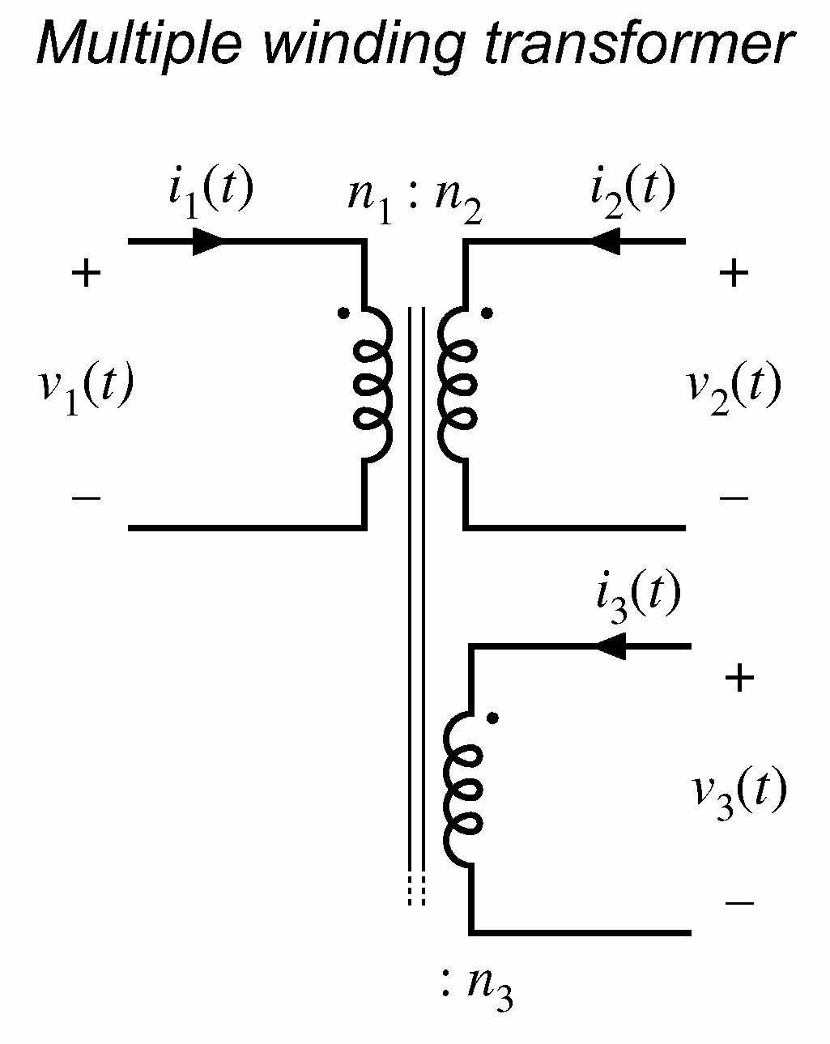
Transformers
The transformer winding connected to the power source is called the primary winding or input winding
The winding connected to the loads is called the secondary winding or output winding
….tertiary winding

Slide 4
Why transformers are important to modern life
The transformer ideally changes one ac voltage level to another voltage level without affecting the actual power supplied.
The transformer can be used in distribution system for efficiency issues.
The step-up transformer decreases the line current and decreases the power loss on power line.
The transmission/distribution system with transformer can keep high efficiency

Slide 5
Voltage levels used in Taipower system
Low voltage : 110V, 220V, 380V
High voltage (HV): 11.4kV, 22.8kV (distribution system)
Extra high voltage (EHV): 69kV, 161kV (transmission system)
Ultra high voltage (UHV): 345kV (transmission system)

Slide 6
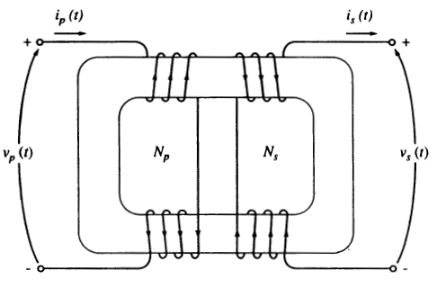
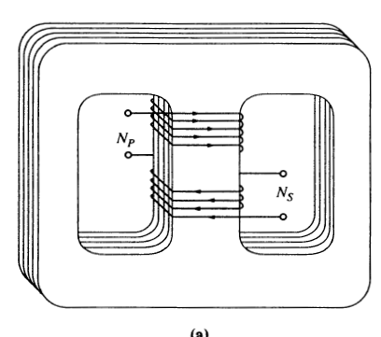
Types and construction of transformers
Core-form: consists a simple rectangular laminated piece of steel with the transformer winding wrapped around two sides of the rectangle
Shell-form: consists three legs laminated core with winding wrapped around the center leg

Slide 7
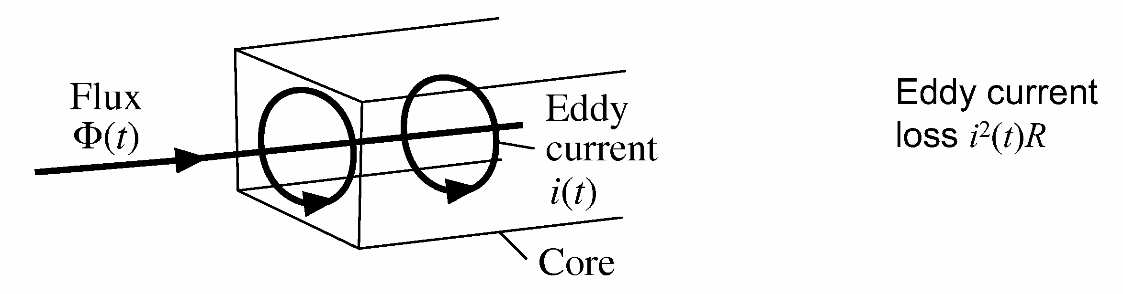
Core material and eddy current
The core is constructed of thin laminations electrically isolated from each other in order to minimize the eddy currents.
Eddy current:

Slide 8
Special purpose transformers
Unit transformer: used for voltage up from generator to transmission system.
Substation transformer: used for voltage down from transmission to distribution
Distribution transformer: used for voltage down from distribution to actual used levels
Potential transformer (PT): 110V at secondary side
Current transformer (CT): 5A at secondary side

Slide 9
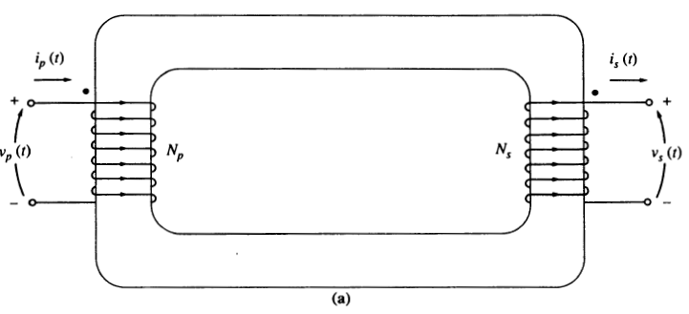
The ideal transformer characteristics

Slide 10
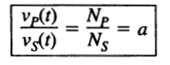
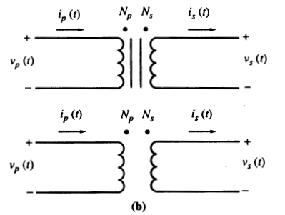
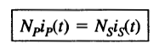
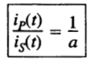
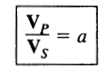
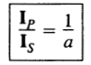
The ideal transformer characteristics
Where a=N_{p}/N_{s} is the turns ratio
Energy balance relation
Phasor relation
The turns ratio a only effects the magnitude not the angle

Slide 11
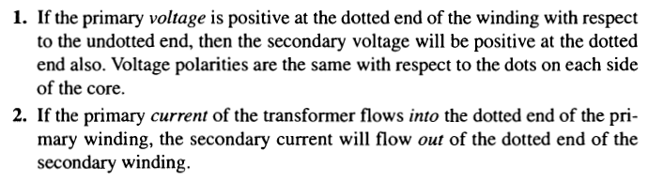
Dot convention in ideal transformer

Slide 12
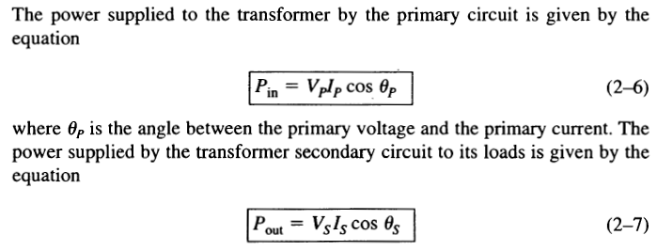
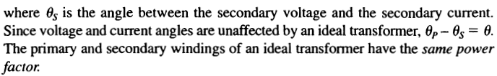
Power in an ideal transformer

Slide 13
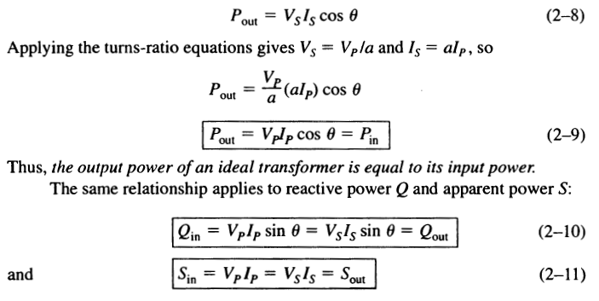
Power in an ideal transformer

Slide 14
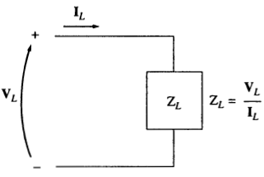
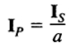
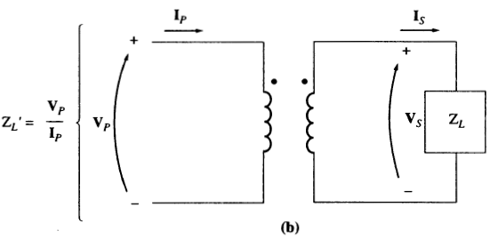
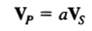
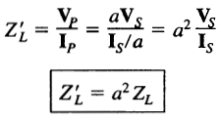
Impedance transformation through a transformer

Slide 15
Analysis of circuits containing ideal transformers
All the current and voltage are all referred to one side (primary side)
Note the dot convention for current direction
Impedance transformation

Slide 16
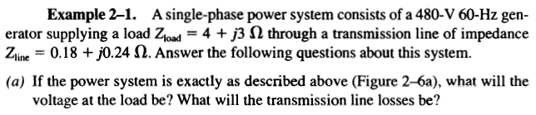
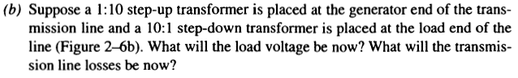
Example 2-1

Slide 17
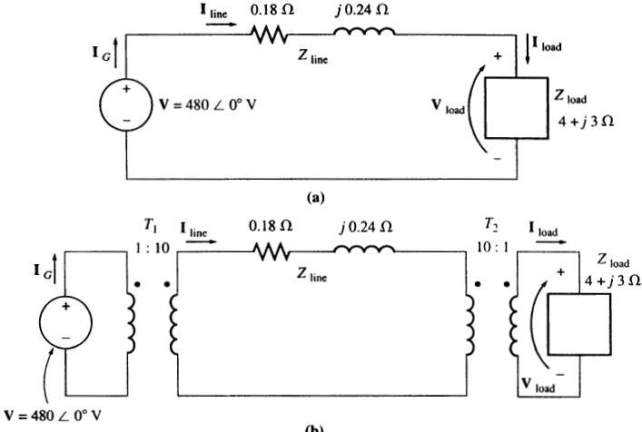
Example 2-1

Slide 18
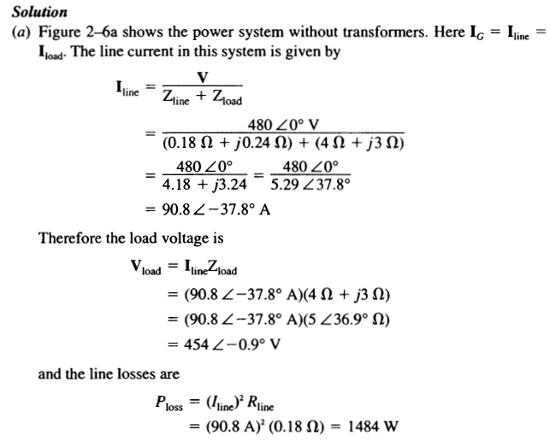

Slide 19
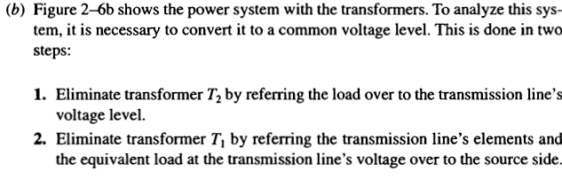
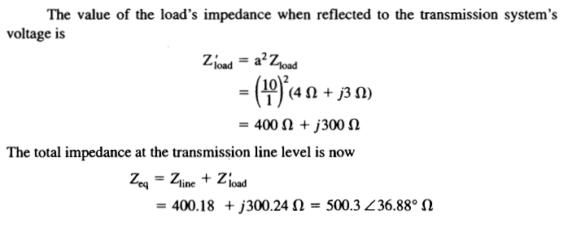

Slide 20
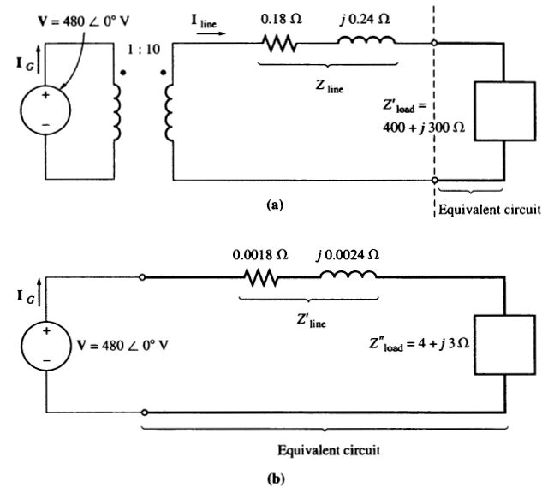

Slide 21
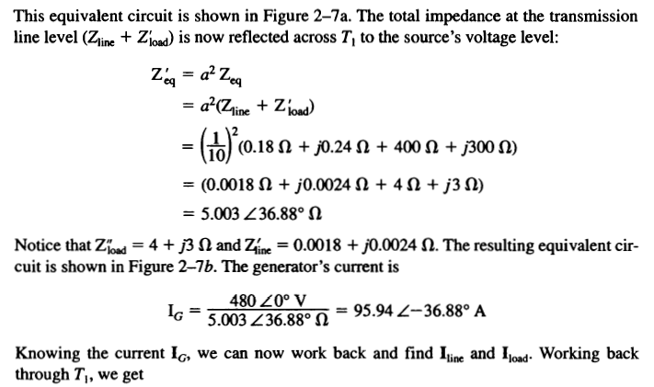

Slide 22
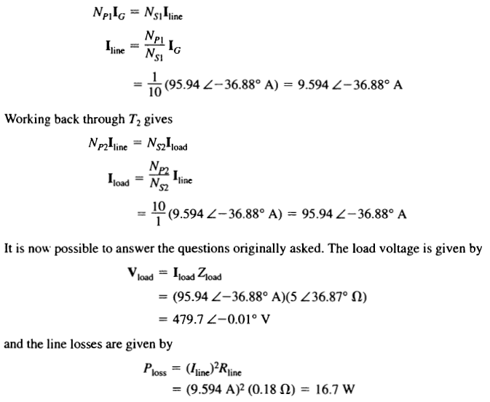

Slide 23
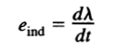
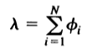
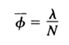
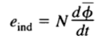
Induced voltage and flux linkage λ
The induced voltage
The flux linkage
Simplified by average flux
The final induced voltage

Slide 24
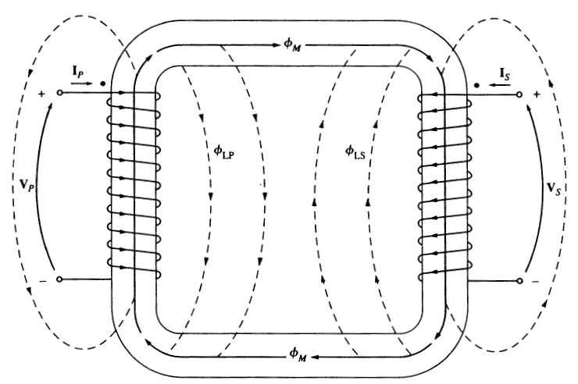
Voltage relation between primary and secondary derived from Faraday’s law

Slide 25
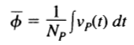
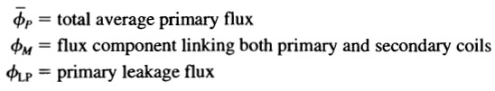
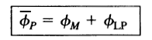
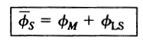
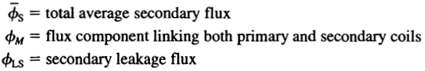
Voltage relation
Induced voltage on each side
Primary side flux
Secondary side flux

Slide 26
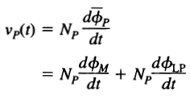
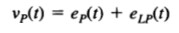
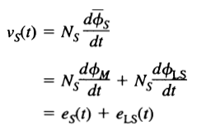
Voltage relation
Induced voltage on primary side
Induced voltage on secondary side

Slide 27
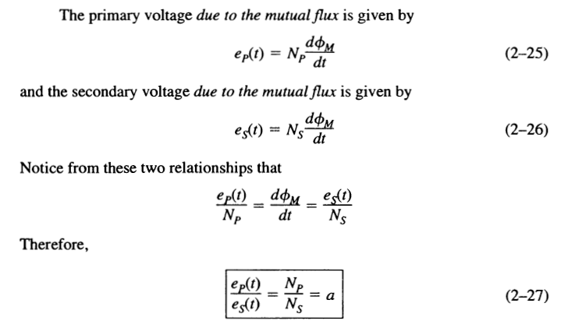
Induced voltage relation - Induced by mutual flux

Slide 28
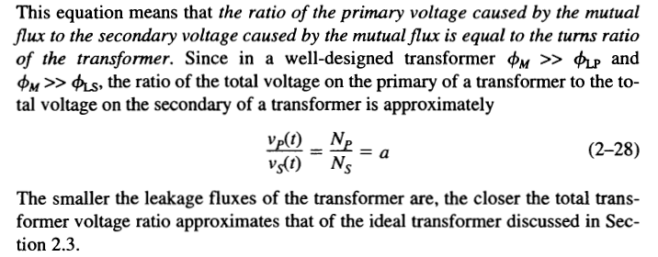
Terminal voltage relation - Neglecting the leakage flux

Slide 29
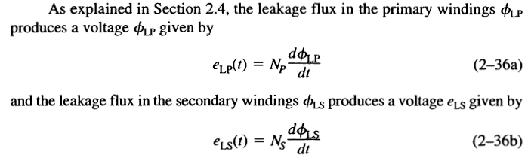
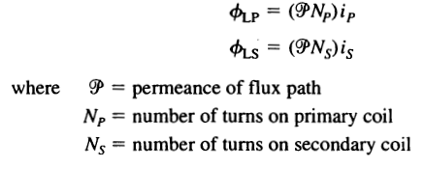
Modeling the leakage flux by leakage inductance

Slide 30
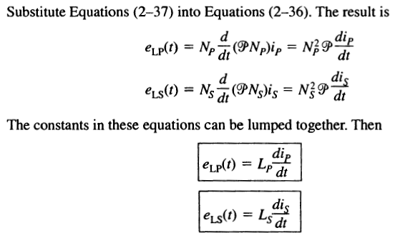
Modeling the leakage flux by leakage inductance

Slide 31
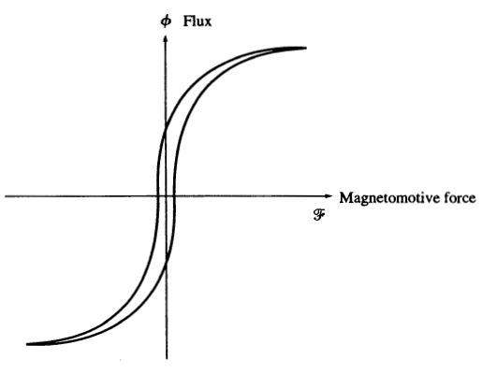
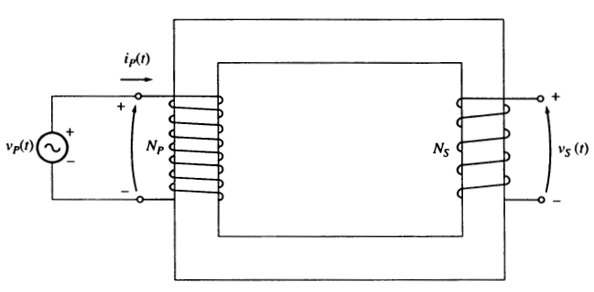
Theory of operation of real single-phase transformers – secondary side open
Secondary side is open circuit
Input voltage and current to measure hysteresis curve
Flux is proportional to v_{p} and magnetomotive force is proportional to i_{p}
i_{p}(t) = 0 for ideal transformer

Slide 32
Magnetization current in real transformer
The magnetization current i_{M} is used to generate mutual flux φ_{M}
While secondary side is opened, the current measured at primary side contains two parts and is called the excitation current i_{ex}
Magnetization current i_{M}: to generate mutual flux
Core loss current i_{h+e} : hysteresis and eddy currents

Slide 33
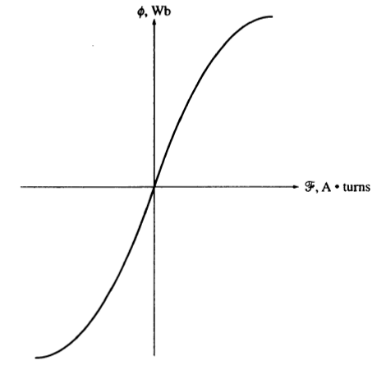
Magnetization curve

Slide 34


Magnetization current

Slide 35

Magnetization current

Slide 36


Core loss current

Slide 37


Excitation current i_{ex}

Slide 38

Current ratio on a transformer

Slide 39
Polarity of the magnetomotive force
Current flows into “Dot” will produce a positive magnetomotive force
Current flows out “Dot” will produce a negative magnetomotive force

Slide 40

The net magnetomotive force and magnetic circuit

Slide 41



Ideal transformer

Slide 42

The assumptions from real to ideal transformer

Slide 43

The equivalent circuit of a transformer – to model the non-ideal characteristics

Slide 44
Modeling excitation current and copper loss
The hysteresis and eddy currents is in-phase with input voltage (modeled as a shunt resistor R_{c})
The magnetization current is lagging input voltage by 90 degrees (modeled as a shunt inductor X_{m})
The copper loss can be modeled as the series resistors R_{p} and R_{s}

Slide 45

The resulting equivalent circuit

Slide 46

Impedance transform to primary or secondary side

Slide 47

Approximate equivalent circuit

Slide 48

Neglecting excitation current

Slide 49
Measure the equivalent circuit parameters
There are two types of measurements used for determination the equivalent circuit parameters
Open circuit test – used to measure excitation branch
Short circuit test – used to measure series branch

Slide 50

Open circuit test

Slide 51





Open circuit test
Under the open circuit condition, all the input current flows through the excitation branch (Since the current is small, the test usually performs at high voltage side)

Slide 52

Short circuit test

Slide 53





Short circuit test
At secondary side short circuit condition, the input voltage must be a very low value to prevent input large short circuit current (usually performs at low voltage side)

Slide 54

Example 2-2

Slide 55


Slide 56


Slide 57


Slide 58

Transformer voltage regulation and efficiency

Slide 59

How to calculate the voltage regulation – transformer phasor diagram
Use the phasor relation to obtain the voltage regulation

Slide 60

Phasor diagram - lagging

Slide 61

Phasor diagram - unit

Slide 62

Phasor diagram - leading

Slide 63

Approximation

Slide 64


Transformer efficiency

Slide 65

Transformer efficiency

Slide 66

Example 2-5

Slide 67


Slide 68



Slide 69



Slide 70


Slide 71


Slide 72


Slide 73


Slide 74

Transformer taps and voltage regulation
The taps of transformer is used to change the effective turns ratio of transformer

Slide 75
TCUL and voltage regulator
The tape changing under load (TCUL) is a transformer with the ability to change taps while power is connected to it
The voltage regulator is the TCUL with voltage sensing circuitry that automatically change taps to maintain the output voltage level

Slide 76

The autotransformer
Continuously tune the output voltage magnitude
The size of auto transformer is smaller than the size of conventional transformer
Output terminal is not electrical isolation

Slide 77

The step-up connection of autotransformer from conventional transformer

Slide 78

The step-down connection of autotransformer

Slide 79



Voltage and current in both coils
Coil voltage and current in Nc and Nse still follow the voltage and current relation
The autotransformer terminal voltage and current

Slide 80

Terminal voltage and current relation of autotransformer

Slide 81


Terminal voltage and current relation of autotransformer

Slide 82




Apparatus power rating advantage in autotransformer
There are two types of rating
Power rating on terminals Sio
Power rating on windings Sw
Terminals power rating Sio
Winding power rating Sw

Slide 83



Apparatus power rating advantage in autotransformer
Relation

Slide 84

Example 2-7

Slide 85



Slide 86


Slide 87
Autotransformer summarize
When two voltages are fairly close to each other
The power advantage is very large
There is a direct physical connection between primary and secondary sides.
The autotransformer is a convenient and inexpensive way to tie nearly equal two voltages together
The electrical isolation of two sides is lost

Slide 88

Example 2-8

Slide 89


Slide 90

Three-phase transformer – three single-phase transformer banks

Slide 91

Three-phase transformer – one three-lags transformer banks

Slide 92

Three types of terminal connection

Slide 93



Wye-wye connection

Slide 94

Wye-wye connection

Slide 95

Wye-wye connection

Slide 96

Wye-wye connection

Slide 97
Solving the unbalance and 3rd harmonic problems in wye-wye connection
Solid ground the neutral of transformers: solve the unbalance problem and support a return path to the 3rd harmonic component.
Add a Δ-connected third winding: Since 3rd harmonic components are in-phase in each branch of Δ-connection, 3rd harmonic components will be limited in Δ-connection as the circulating current.

Slide 98




Wye-delta connection

Slide 99

Wye-delta connection

Slide 100
Wye-delta connection summarize
No 3rd harmonic component problem:
There are phase difference between each sides
In United state, the secondary voltage will lag the primary voltage 30 degrees

Slide 101
Phase analysis

Slide 102

Delta-wye connection

Slide 103

Delta-wye connection

Slide 104
Phase analysis

Slide 105
Delta-wye connection
Common connection:
Used on three-wire (delta) to four wire (wye)
Used to isolate ground on wye side from source ground on delta side

Slide 106
Delta-wye or wye-delta
Common for wye-delta step-up transformer banks in generating plants
Common for delta-wye step-down banks in substation

Slide 107


Delta-delta connection

Slide 108

Delta-delta connection

Slide 109

Three-phase transformation using two transformers

Slide 110


V-V connection

Slide 111


Power rating of Δ-Δ connection

Slide 112




Power rating of V-V connection

Slide 113



Comparison of power rating
The power rating comparison
Where is the power rating ?
The existing reactive power will consume the power rating

Slide 114

Open Y-open Δ connection

Slide 115

Scott-T connection – railroad applications
While in railroad applications, there always need two-phase power system for supporting northbound and southbound rails respectively.

Slide 116


Slide 117

T-T three phase connection

Slide 118

T-T three phase connection

Slide 119



Transformer rating and relative problems
Voltage rating
Prevent the over-voltage insulation problem
Prevent the saturation of magnetization curve

Slide 120


Slide 121

Frequency limitation
If a 60Hz transformer operates on 50Hz, its applied voltage must be reduced by one-sixth
If a 50Hz transformer operates on 60Hz, its applied voltage may rise 20 percents.

Slide 122



Inrush current problem

Slide 123

Instrument transformer
Potential transformer (PT)
Current transformer (CT)

Slide 124
Recap
You must know the magnetization current, core loss current and excitation current
You must know the equivalent circuit of real transformer
Voltage regulation and efficiency of transformer
The differences between four types connection of three-phase transformer
V-V connection, Scott T connection

